Slide 1
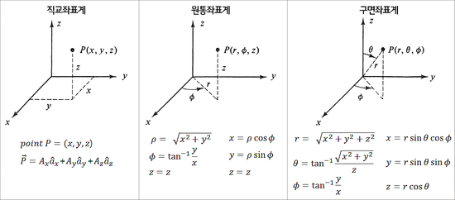
$$r$$
$$r$$
$$r$$
$$r$$
$$r$$
$$r$$
$$r$$
$$r$$
$$r$$

Slide 2
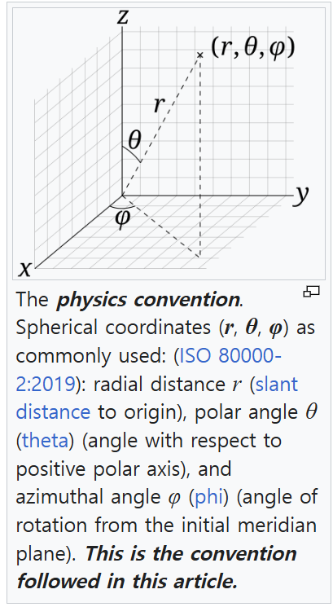
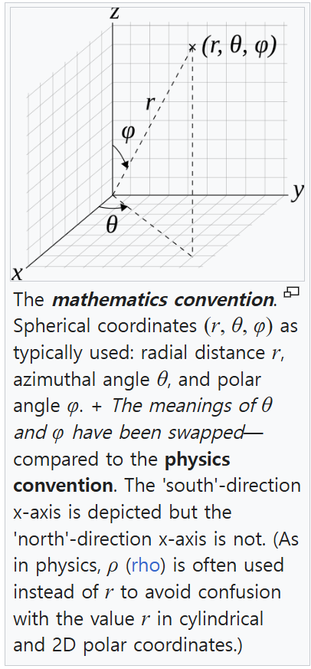

Slide 3

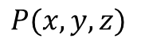
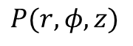

Yaw
Z
Y
Pitch
X
Roll
직교 좌표계
원통 좌표계
Yaw
Z
Yaw
Z
$$P(x, y, z)$$
$$P(r, φ, z)$$
z
Y
z
Y
Pitch
$$r$$
Pitch
x
X
X
$$ϕ$$
Roll
y
Roll

Slide 4

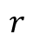

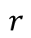
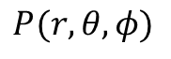
직교 좌표계
구면 좌표계
Yaw
Z
Yaw
Z
$$P(x, y, z)$$
$$P(r, θ, φ)$$
$$θ$$
$$r$$
z
Y
Y
Pitch
Pitch
x
X
X
$$ϕ$$
Roll
y
Roll
원통 좌표계
구면 좌표계
Yaw
Z
Yaw
Z
$$P(r, φ, z)$$
$$P(r, θ, φ)$$
$$θ$$
$$r$$
z
Y
Y
$$r$$
Pitch
Pitch
X
$$ϕ$$
X
$$ϕ$$
Roll
Roll

Slide 5


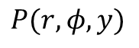
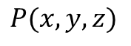



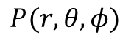
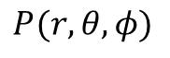



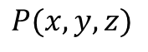
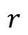
직교 좌표계
원통 좌표계
Z
Z
Roll
Roll
$$ϕ$$
X
$$r$$
X
Pitch
Pitch
구면 좌표계
$$P(x, y, z)$$
$$P(r, φ, y)$$
Yaw
Z
$$P(r, θ, φ)$$
Y
Yaw
Y
Yaw
$$r$$
직교 좌표계
구면 좌표계
Y
Pitch
Z
Z
X
$$ϕ$$
Roll
Roll
Roll
$$ϕ$$
X
X
직교 좌표계
원통 좌표계
Pitch
$$θ$$
Pitch
$$P(x, y, z)$$
$$r$$
Yaw
Z
Yaw
Z
$$P(r, θ, φ)$$
$$P(x, y, z)$$
$$P(r, φ, z)$$
Y
Yaw
Y
Yaw
z
Y
z
Y
Pitch
$$r$$
Pitch
원통 좌표계
구면 좌표계
x
X
X
$$ϕ$$
Roll
y
Roll
Z
Z
Roll
Roll
$$ϕ$$
$$ϕ$$
$$r$$
X
X
Pitch
$$θ$$
Pitch
$$r$$
$$P(r, φ, y)$$
$$P(r, θ, φ)$$
Y
Yaw
Y
Yaw

Slide 6

원통 좌표계
구면 좌표계
직교 좌표계
원통 좌표계
Z
Z
Roll
Roll
Z
Z
Roll
Roll
$$ϕ$$
$$ϕ$$
$$r$$
X
$$ϕ$$
X
Pitch
X
$$r$$
X
$$θ$$
Pitch
$$r$$
Pitch
Pitch
$$P(r, φ, y)$$
$$P(r, θ, φ)$$
$$P(x, y, z)$$
$$P(r, φ, y)$$
Y
Yaw
Y
Yaw
Y
Yaw
Y
Yaw
$$z$$
$$φ$$
$$r$$
$$x$$
원통 좌표계
구면 좌표계
Z
Z
Roll
Roll
$$ϕ$$
$$ϕ$$
$$r$$
X
X
Pitch
$$θ$$
Pitch
$$r$$
$$P(r, φ, y)$$
$$P(r, θ, φ)$$
Y
Yaw
Y
Yaw

Slide 7
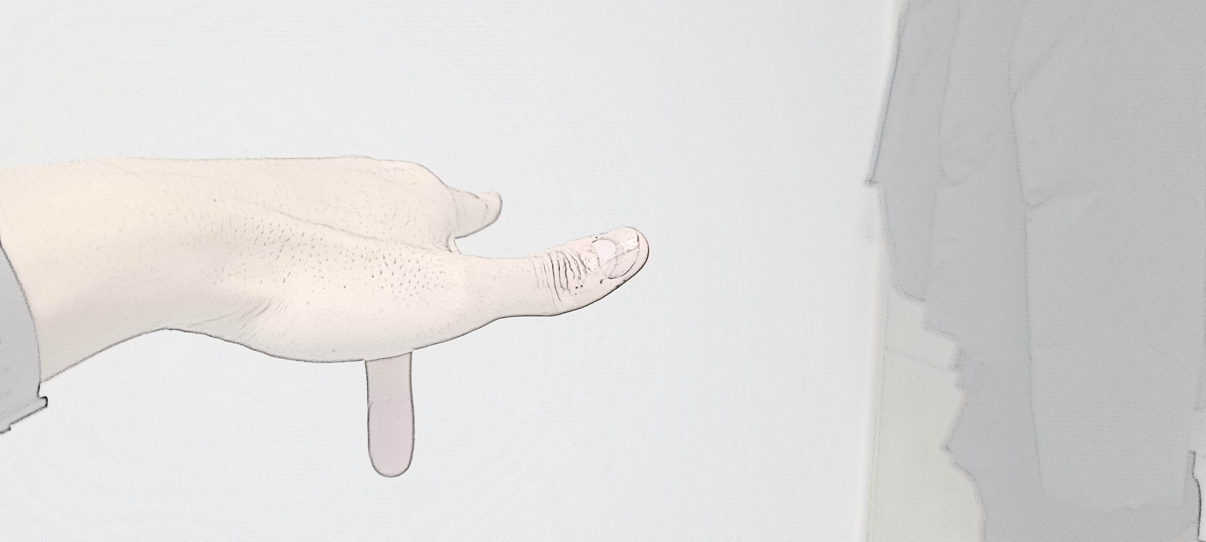

Z
(up)
Z
(forward)
X
X
(forward)
(right)
Y
(left)
Y
(down)

Slide 8
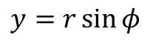
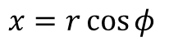
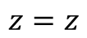

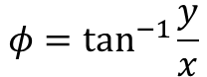
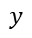
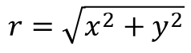
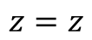
$$y$$
$$r$$
$$φ$$
$$x$$
$$r$$
$$r$$
$$r$$
원통 좌표계
직교 좌표계
$$r=\sqrt{x^{2}+y^{2}}$$
$$x=r\cos{φ}$$
$$φ=\tan^{−1}{\frac{y}{x}}$$
$$y=r\sin{φ}$$
$$z=z$$
$$z=z$$

Slide 9
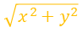
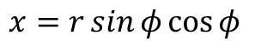
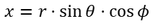

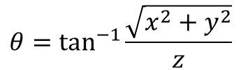
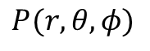

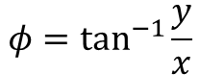
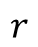
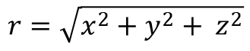
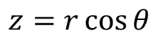


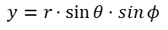
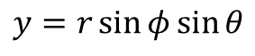
구면 좌표계
직교 좌표계
$$r=\sqrt{x^{2}+y^{2}+ z^{2}}$$
$$x=r\sin{φ\cos{φ}}$$
$$r$$
$$r$$
$$r$$
$$θ=\tan^{−1}{\frac{\sqrt{x^{2}+y^{2}}}{z}}$$
$$y=r\sin{φ}\sin{θ}$$
$$φ=\tan^{−1}{\frac{y}{x}}$$
$$z=r\cos{θ}$$
구면 좌표계
구면 좌표계
Yaw
Z
Yaw
Z
$$P(r, θ, φ)$$
$$P(r, θ, φ)$$
$$r\sin{θ}$$
$$θ$$
$$θ$$
$$y=r⋅sin{θ⋅\sin{φ}}$$
$$r$$
$$r$$
Y
Y
$$φ$$
Pitch
Pitch
$$x=r⋅sin{θ⋅\cos{φ}}$$
$$ϕ$$
$$\sqrt{x^{2}+y^{2}}$$
X
$$ϕ$$
X
Roll
Roll

Slide 10
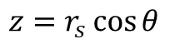
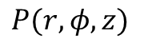
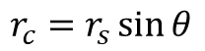

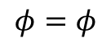
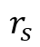
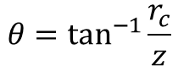

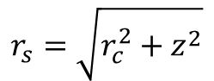
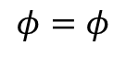
$$r$$
$$r$$
$$r$$
원통 좌표계
구면 좌표계
원통 좌표계
구면 좌표계
Yaw
Z
Yaw
Z
$$P(r, φ, z)$$
$$P(r, θ, φ)$$
$$r_{c}=r_{s}\sin{θ}$$
$$r_{s}=\sqrt{r_{c}^{2}+z^{2}}$$
$$θ$$
$$r_{s}$$
z
Y
Y
$$φ=φ$$
$$θ=\tan^{−1}{\frac{r_{c}}{z}}$$
$$r_{c}$$
Pitch
Pitch
$$ϕ$$
$$\sqrt{x^{2}+y^{2}}$$
$$z=r_{s}\cos{θ}$$
$$ϕ$$
$$φ=φ$$
X
X
Roll
Roll

Slide 11
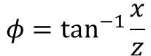
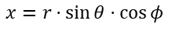
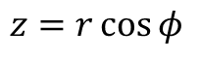
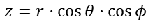
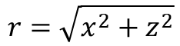
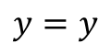
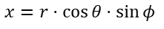
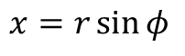

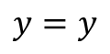

원통 좌표계
직교 좌표계
$$r=\sqrt{x^{2}+z^{2}}$$
$$x=r\sin{φ}$$
$$φ=\tan^{−1}{\frac{x}{z}}$$
$$y=y$$
$$y=y$$
$$z=r\cos{φ}$$
$$r\cos{θ}$$
$$r\sin{θ}$$
$$z=r⋅\cos{θ⋅\cos{φ}}$$
$$φ$$
$$φ$$
$$x=r⋅\cos{θ⋅\sin{φ}}$$
$$x=r⋅sin{θ⋅\cos{φ}}$$

Slide 12














구면 좌표계
구면 좌표계
직교 좌표계
Z
$$r=\sqrt{x^{2}+y^{2}+z^{2}}$$
$$x=r\cos{θ}\sin{φ}$$
Roll
$$ϕ$$
$$θ=\sin^{−1}{\frac{y}{r}}$$
$$y=r\sin{θ}$$
X
$$θ$$
Pitch
$$φ=\tan^{−1}{\frac{x}{z}}$$
$$r$$
$z=r\cos{θ}\cos{φ}$
$$P(r, θ, φ)$$
Y
Yaw
원통 좌표계
구면 좌표계
원통 좌표계
구면 좌표계
$$r_{s}=\sqrt{r_{c}^{2}+y^{2}}$$
$$r_{c}=r_{s}\cos{θ}$$
Z
Z
Roll
Roll
$$φ=φ$$
$$θ=\tan^{−1}{\frac{y}{r_{c}}}$$
$$ϕ$$
$$ϕ$$
$$r_{c}$$
X
X
$$y=r_{s}\sin{θ}$$
$$φ=φ$$
Pitch
$$θ$$
Pitch
$$r_{s}$$
$$P(r, φ, y)$$
$$P(r, θ, φ)$$
Y
Yaw
Y
Yaw

